Slide 1

Vidyavardhini’s College of Engineering & Technology
Department of Computer Science and Engineering (Data Science)
Academic Year: 2023-24
Fund Transfer Using Ethereum
GROUP NO: 02
Jignesh Gurav - 16
Jayesh Ingale - 18
Aman Mishra - 35
Under the guidance of
(Prof.Sumeet Shingi)

Slide 2
Table of Contents
Introduction
Problem Statement
Literature Survey
Proposed System
Architecture/Framework/Block diagram/Algorithm/Process Design
Details of Hardware/Software used
Output
Result Analysis
Conclusion
References

Slide 3
Introduction
"Blockchain Technology" is the technique in which records of transactions made ethereum or another cryptocurrency are saved in blocks and maintained across all computers connected in a peer-to-peer network.
It secures the transactions in such a way that any record of transactions that occurred in the past cannot be modified, as the modification changes the hash of several blocks.
All the peers connected to that system do not support that modification, excluding the modifier. Ethereum is a cryptocurrency-based system based on blockchain technology with the currency "Ether" as its name. Ethereum is a platform that allows people to create decentralized applications or adopt them for short periods, and ethereum clients will be developed.
It can construct trustworthy and transparent financial apps since it is built on the blockchain. An online, cryptographically secure system that lets individuals preserve ownership of their data benefits from managed property and contracts, social networking, and messaging platforms (Ethereum Community,2016).
Cryptocurrency is a digital or virtual currency that may be used to make payments.

Slide 4
Problem Statement
In the rapidly growing landscape of decentralized finance (DeFi) and blockchain-based financial transactions, there exists a need for a more efficient, user-friendly, and cost-effective fund transfer mechanism using Ethereum.
Existing solutions often suffer from high gas fees, network congestion, and complex user interfaces, making it challenging for the average person to seamlessly send and receive funds on the Ethereum network.
Moreover, there is a lack of user-friendly tools and platforms that integrate with existing financial services and provide a bridge between traditional banking systems and the Ethereum blockchain. This creates a barrier to entry for individuals and businesses looking to harness the benefits of blockchain technology for fund transfers, such as increased security, transparency, and accessibility.
Our aim is to develop a user-centric, secure, and interoperable Ethereum-based fund transfer solution that addresses these challenges. Success will be measured by the significant reduction in transaction fees, faster confirmation times, and a seamless user experience that caters to both cryptocurrency enthusiasts and mainstream users while enabling easy integration with traditional financial systems and services.

Slide 5
Literature Survey
Sr. No | Paper Title | Advantages | Disadvantages
1 | Blockchain based Peer to Peer Money Transfer using Cryptocurrency | Eliminates the need for intermediaries, such as banks, in P2P transactions, allowing users to have more control over their funds and reducing the risk of censorship or control by centralized authorities. | The lack of regulatory oversight in the cryptocurrency space can lead to security and fraud risks, as well as potential legal issues in certain jurisdictions.
2 | Decentralized Finance and Crypto Banking System Using Ethereum-based Blockchain Technology | Anyone with an internet connection can participate in DeFi and crypto banking, making financial services accessible 24/7 from anywhere in the world. | Cryptocurrencies are highly volatile, which can result in significant price fluctuations, leading to potential losses for users and instability in DeFi platforms.
3 | Ethereum Blockchain based smart contract for Secured transactions between Founders/Entrepreneurs and Contributors under Start-up Projects | Ethereum smart contracts are transparent and provide all parties with a clear view of the terms and conditions of the transaction, enhancing trust and reducing disputes. | Creating and managing smart contracts can be complex, requiring a level of technical expertise that may be a barrier for some entrepreneurs and contributors.

Slide 6
Literature Survey
Sr. No | Paper Title | Advantages | Disadvantages
4 | Foreign money transfer using blockchain | Blockchain-based foreign money transfers can significantly reduce transaction times, with some transactions settling in minutes instead of days, as seen in traditional banking systems. | Blockchain technology may not be well-understood by the general population, potentially creating barriers to its widespread adoption for international money transfers.
5 | Modeling and Understanding Ethereum Transaction Records via A Complex Network Approach | Complex network approaches can handle the vast amount of transaction data on the Ethereum network, making it scalable for research and analysis of large datasets. | Ethereum transaction data is complex and rapidly evolving, making it challenging to preprocess, model, and analyze effectively using complex network approaches.

Slide 7
Proposed System
Fund transfer with Ethereum involves sending and receiving digital assets, typically in the form of Ether (ETH) or other Ethereum-based tokens, over the Ethereum blockchain.
Ethereum is a decentralized blockchain platform that allows for the creation and execution of smart contracts, which are self-executing contracts with the terms of the agreement between parties directly written into code.
This capability makes Ethereum a popular choice for various financial applications, including fund transfers, because it enables trustless and secure transactions without the need for intermediaries like banks.

Slide 8
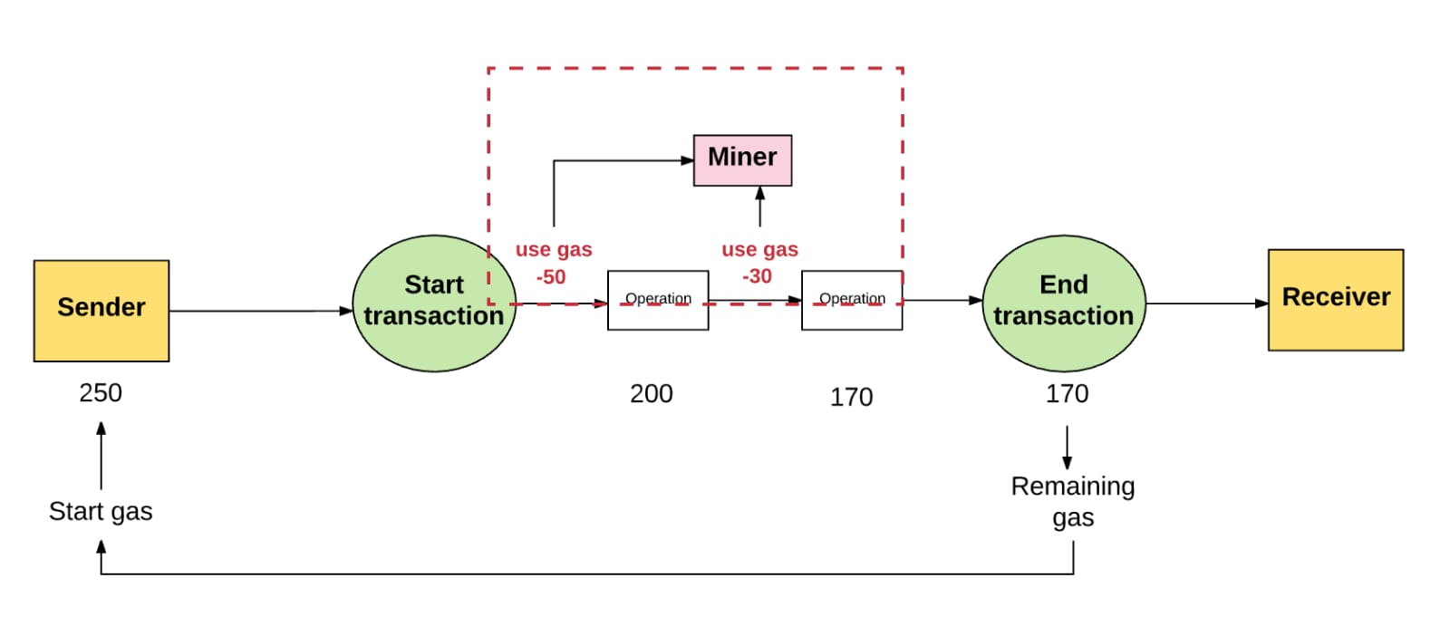
Architecture

Slide 9
Hardware/Software Requirements
Hardware Requirements:
Processor : Intel Core i5 6th Gen.
Ram : 8 GB
System Type : 64 bit O.S
Software Requirements:
Meta Mask
Sepholia (Test Network)
Programming Languages:
Solidity
ReactJS
NodeJS

Slide 10
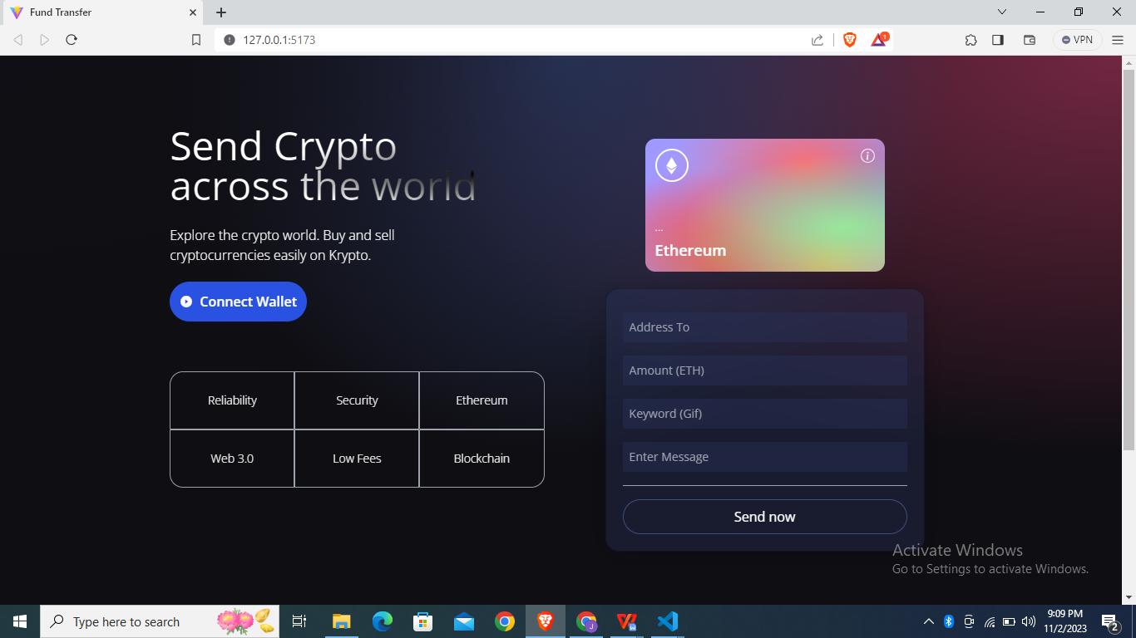
Output
Fig 3.2 User Interface Before Connecting To Metamask

Slide 11
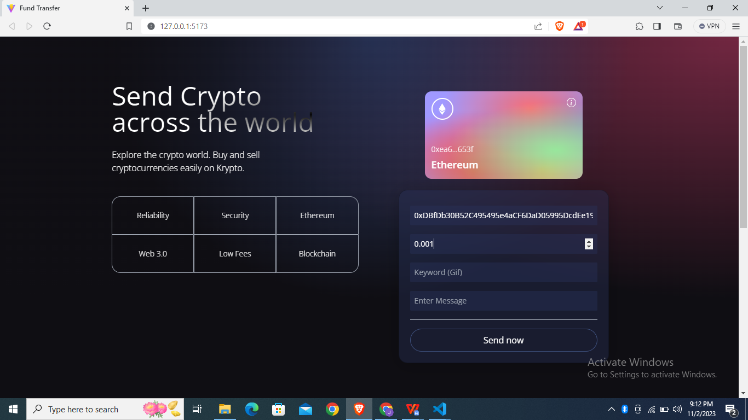
Output
Fig 3.3 After Connecting To MetaMask

Slide 12
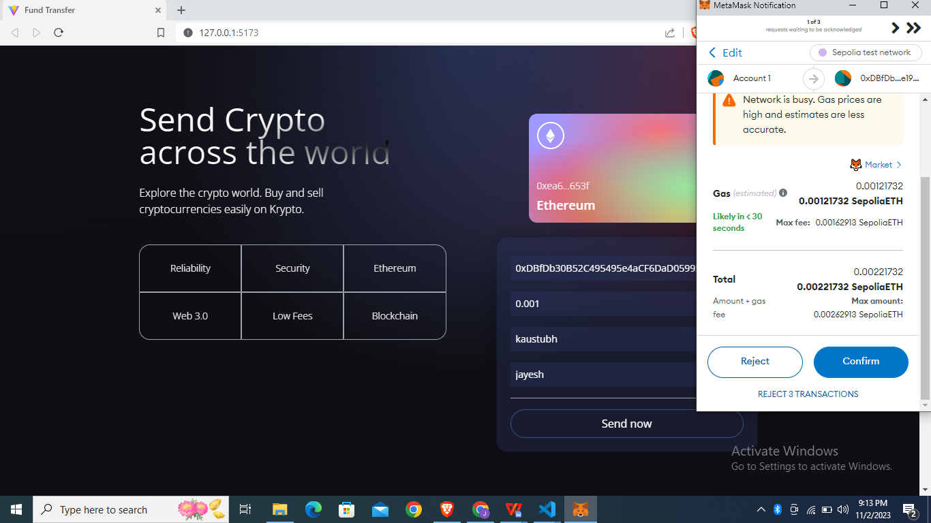
Output
Fig 3.4 Process to Send Token To Another User (Unique Public Address)

Slide 13
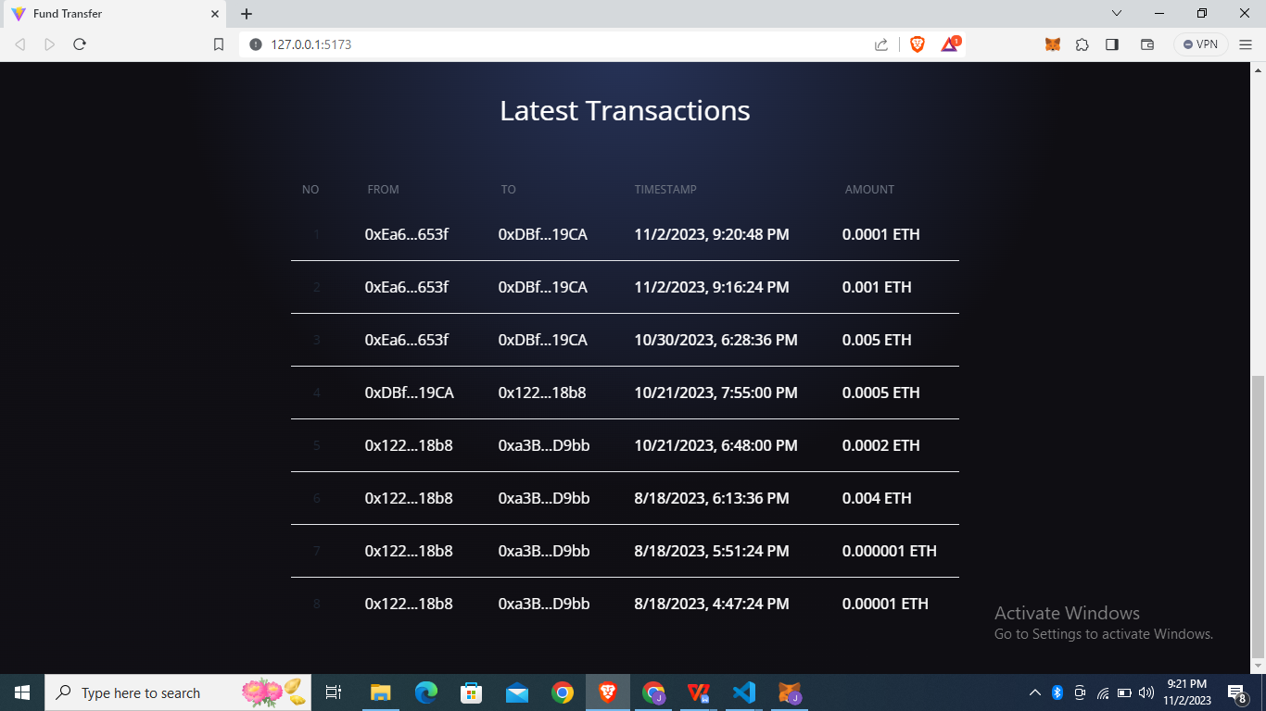
Output
Fig 3.5 Successfully Sent Token (Database)

Slide 14
Result Ananlysis
A Fund transfer system with Ethereum involves evaluating the system's performance, efficiency, and its impact on users and the broader financial landscape,assess transaction speed and efficiency, collect data on the time it takes for transactions to be initiated, confirmed, and settled on the Ethereum network.Used for the usage of supported cryptocurrencies and tokens within the system.
And Examine how users engage with different digital assets, conduct exchanges, and utilize tokens for fund transfers. System Conduct a comparative analysis by benchmarking the system's performance against traditional banking systems and other blockchain-based fund transfer services.
The analysis of a fund transfer system with Ethereum is a critical process that assesses its performance, efficiency, security, user experience, and overall impact on the financial landscape. Through a comprehensive evaluation of the system's various facets, we gain valuable insights into its strengths, weaknesses, and potential areas for improvement.

Slide 15
Conclusion
Fund Transfers with Ethereum provides valuable insights into the benefits and challenges encountered during token transfer or money transfer through ethereum , offering a foundation for continuous improvement and innovation in the field of blockchain-based financial transactions.The thorough examination of the system's performance and user experiences also plays a vital role in driving trust and confidence among users, ensuring their assets and data are secure, and contributing to the ongoing development of blockchain technology within the financial sector.

Slide 16
References
[1] Dan Lin, Jiajing Wu, Qi Yuan, and Zibin Zheng , Modeling and Understanding Ethereum Transaction Records via A Complex Network Approach , 11 November 2020 IEEE
Transactions On Circuits And Systems Vol. 67, No. 11.
[2] Nupur Giri , Dheeraj Singh Jodha , Yash Goyal , Akshay Thite , and Abhay Tiwari , Foreign money transfer using blockchain , 2021 International Conference on Advanced Ceramics and Composites.
[3] Namrata Thakur , Dr. Vinayak D Shinde , Ethereum Blockchain based smart contract for Secured transactions between Founders/Entrepreneurs and Contributors under Start-up Projects , 2021 International Journal of Scientific Research in Computer Science, Engineering and Information Technology.
[4] Mamun Ahmed, Saha Reno , Salma Akter and A. K. M. Abu Nowshad Chowdhury , Decentralized Finance and Crypto Banking System Using Ethereum-based Blockchain Technology, 2021 BAIUST Academic Journal, Volume 2, Issue 1.
[5] Shashidhar M.R , Blockchain based Peer to Peer Money Transfer using Cryptocurrency Digital Wallet July 2020 International Research Journal of Engineering and Technology (IRJET) Volume: 07 Issue: 07

Slide 17
References
[6] John Andrews a, Michele Ciampi b, Vassilis Zikas , Etherless Ethereum tokens: Simulating native tokens in Ethereum , 2023 Journal of Computer and System Sciences 135.
[7] Seongjoon Park, Jaeseung Lee, Hwangnam Kim , Efficient computation offloading for Ethereum DApps , 2023 Journal of Industrial Information Integration 31.
[8] Nami Ashizawa , Naoto Yanai , Jason Paul Cruz , Shingo Okamura , Eth2Vec Learning contract-wide code representations for vulnerability detection on Ethereum smart contracts , 2022 Blockchain Research and Applications Elsevier
[9] Simon Joseph Aquilina , Fran Casino , Mark Vella , Joshua Ellul , Constantinos Patsakis , EtherClue Digital investigation of attacks on Ethereum smart contracts , 2021 Blockchain Research and Applications Elsevier
[10] Andrea Lisi , Andrea De Salve , Paolo Mori , Laura Ricci , Samuel Fabrizi Rewarding reviews with tokens: An Ethereum-based approach , 2021 Future Generation Computer Systems Elsevier

Slide 18
Thank You!!

